Slide 1


Welcome
Year 2 parents
July 2026

Slide 2
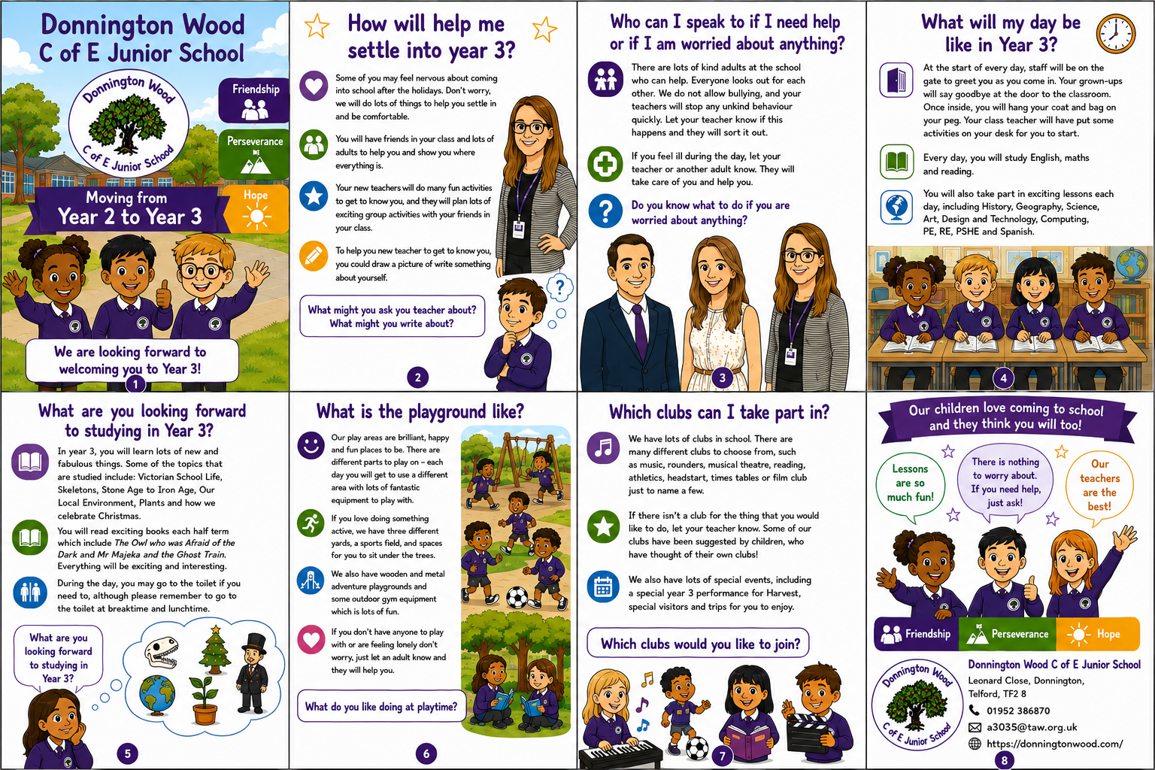

Slide 3

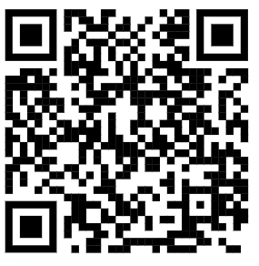
Link to video for School Award
Donnington Wood Church of England Junior School – Together Everyone Achieves More

Slide 4


Slide 5
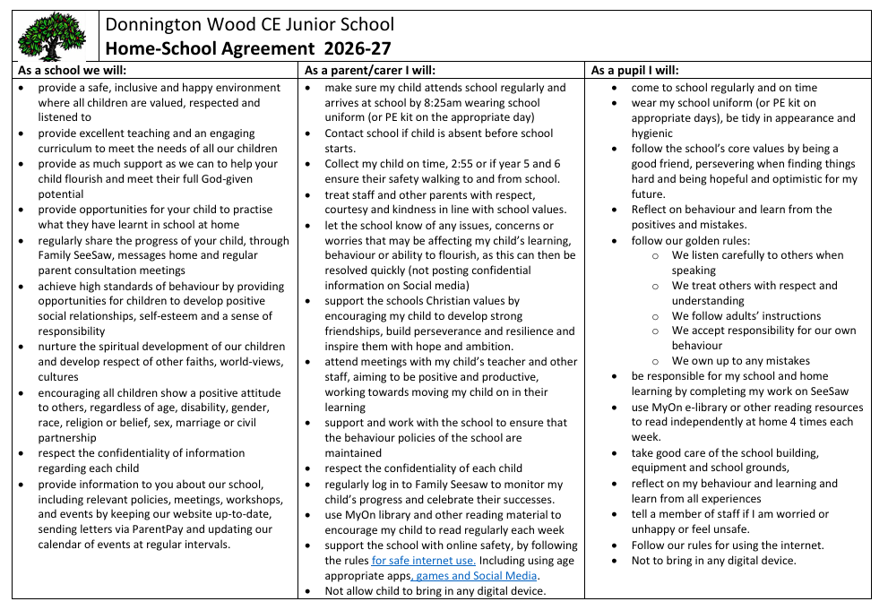

Slide 6

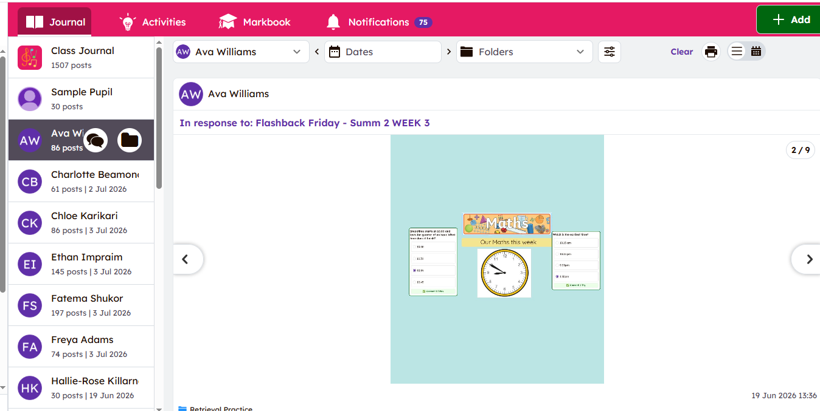

Slide 7



Slide 8

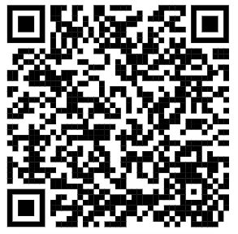
SEND OFFER (Special Educational Needs and Disability) – Donnington Wood Church of England Junior School

Slide 9

We need your help!

Slide 10

September
Day | Detail
Monday 31st Aug | Bank Holiday
Tuesday 1st Sept | PD day – Invite only
Wednesday 2nd Sept | First Day Photo!
Thursday 3rd Sept | School
Friday 4th Sept | School Celebration assembly

Slide 11
Questions?

