Slide 1



Slide 2
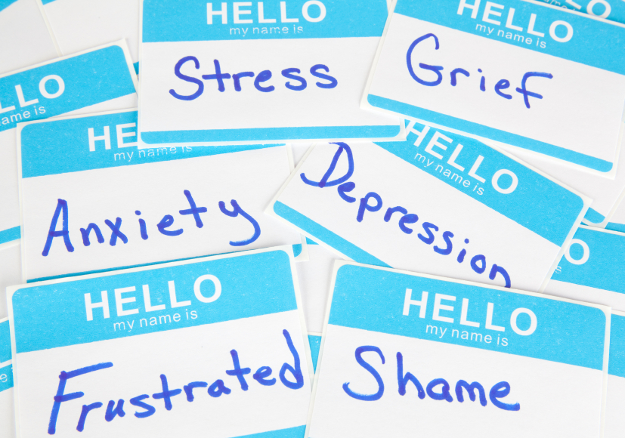
Mental Health
A person’s state of emotional well being
or
A diagnosable condition connected to brain functions

Slide 3
Now watch this short clip what is it about ?
https://youtu.be/kmSinPMVU2U

Slide 4
What causes stress?
Plenty of things can cause stress in a kid's life, and there are such things as good stress and bad stress. Have you ever had butterflies in your stomach or sweaty hands? Those can be signs of good stress — the kind of stress that can help you to get things done. For example, you may do a better job on your book report if the anxiety inspires you to prepare well before you have to read it to the class.
Bad stress can happen if stressful feelings keep going over time. You may not feel well if your parents are fighting, if a family member is sick or if you're having problems at school. That kind of stress isn't going to help you, and it can actually make you sick.

Slide 5
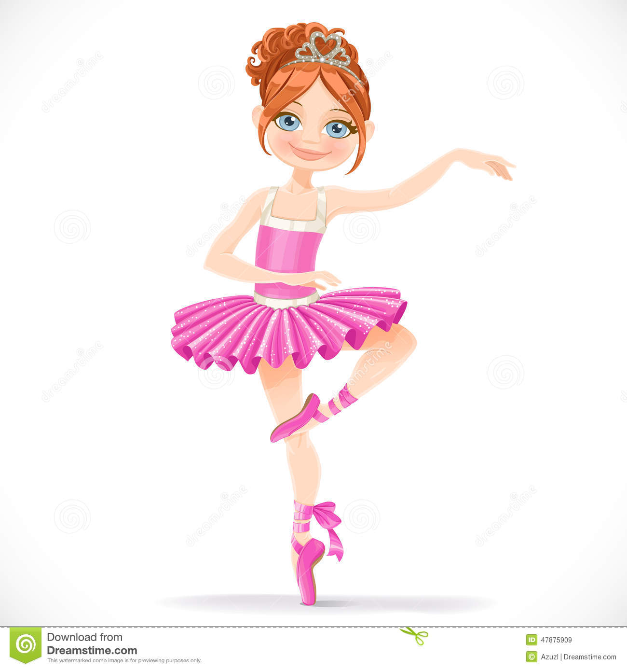
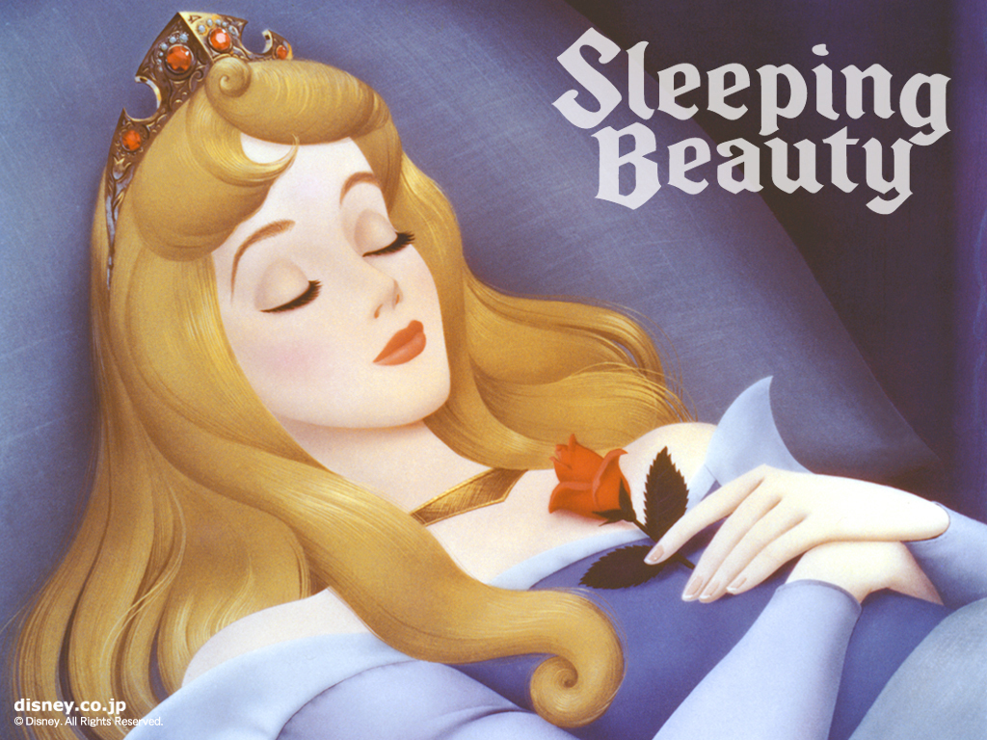
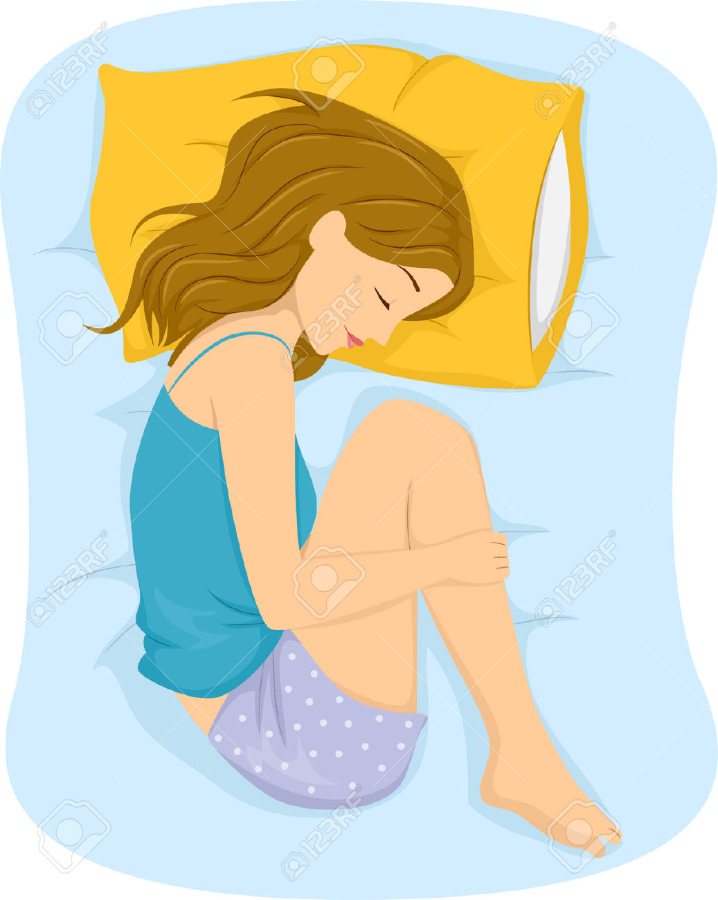
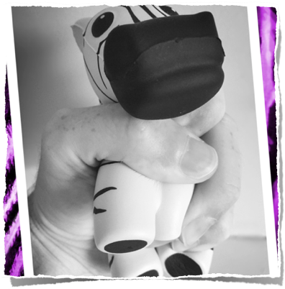

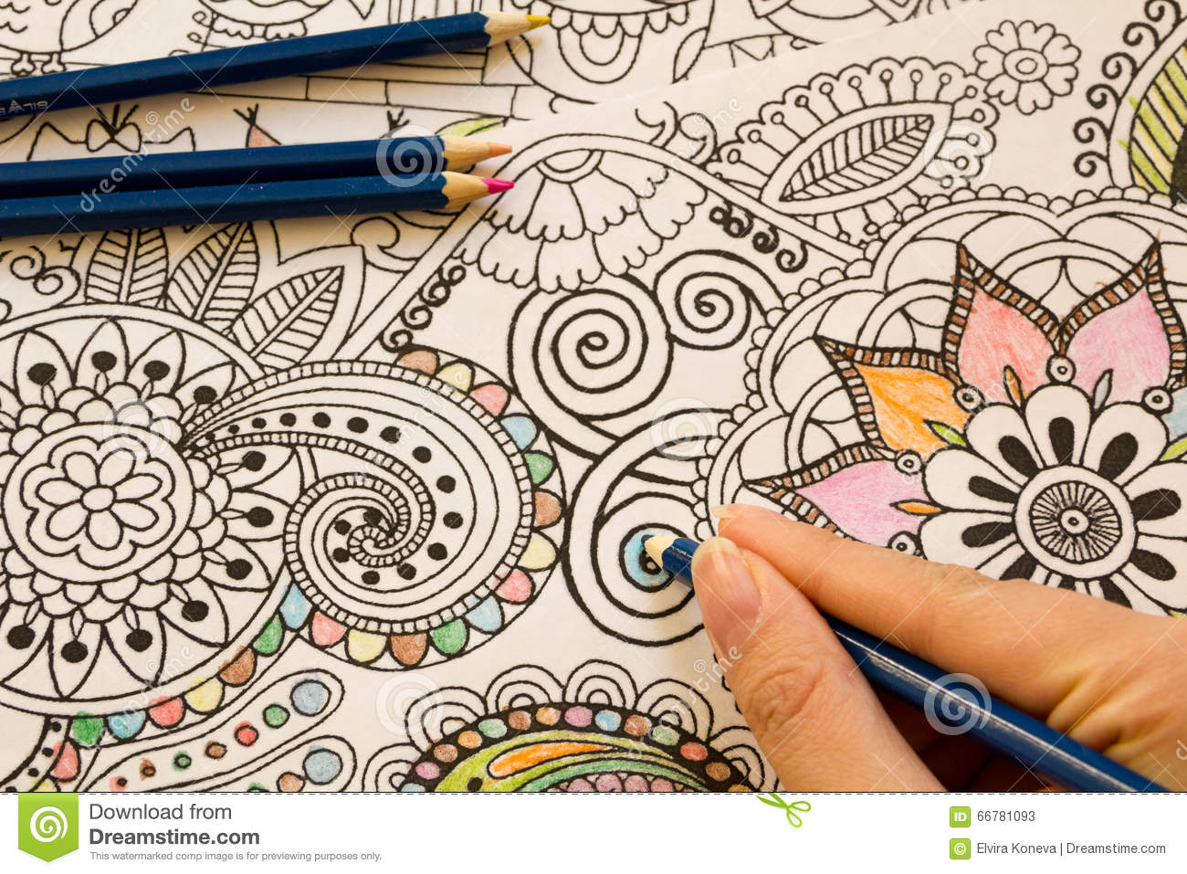
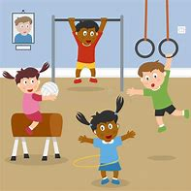
Coping strategies
You could just do some colouring, sleep, play games, play some music or do some exercise .
If you don’t know what to do then you could ask someone and don’t be afraid to talk to someone trusted

Slide 6

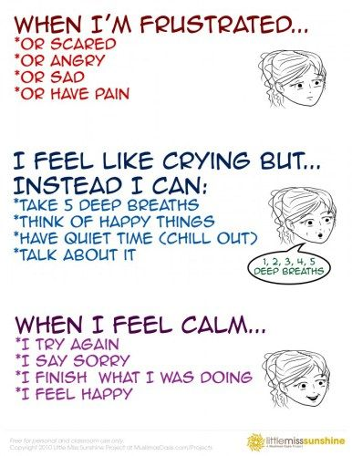

Slide 7
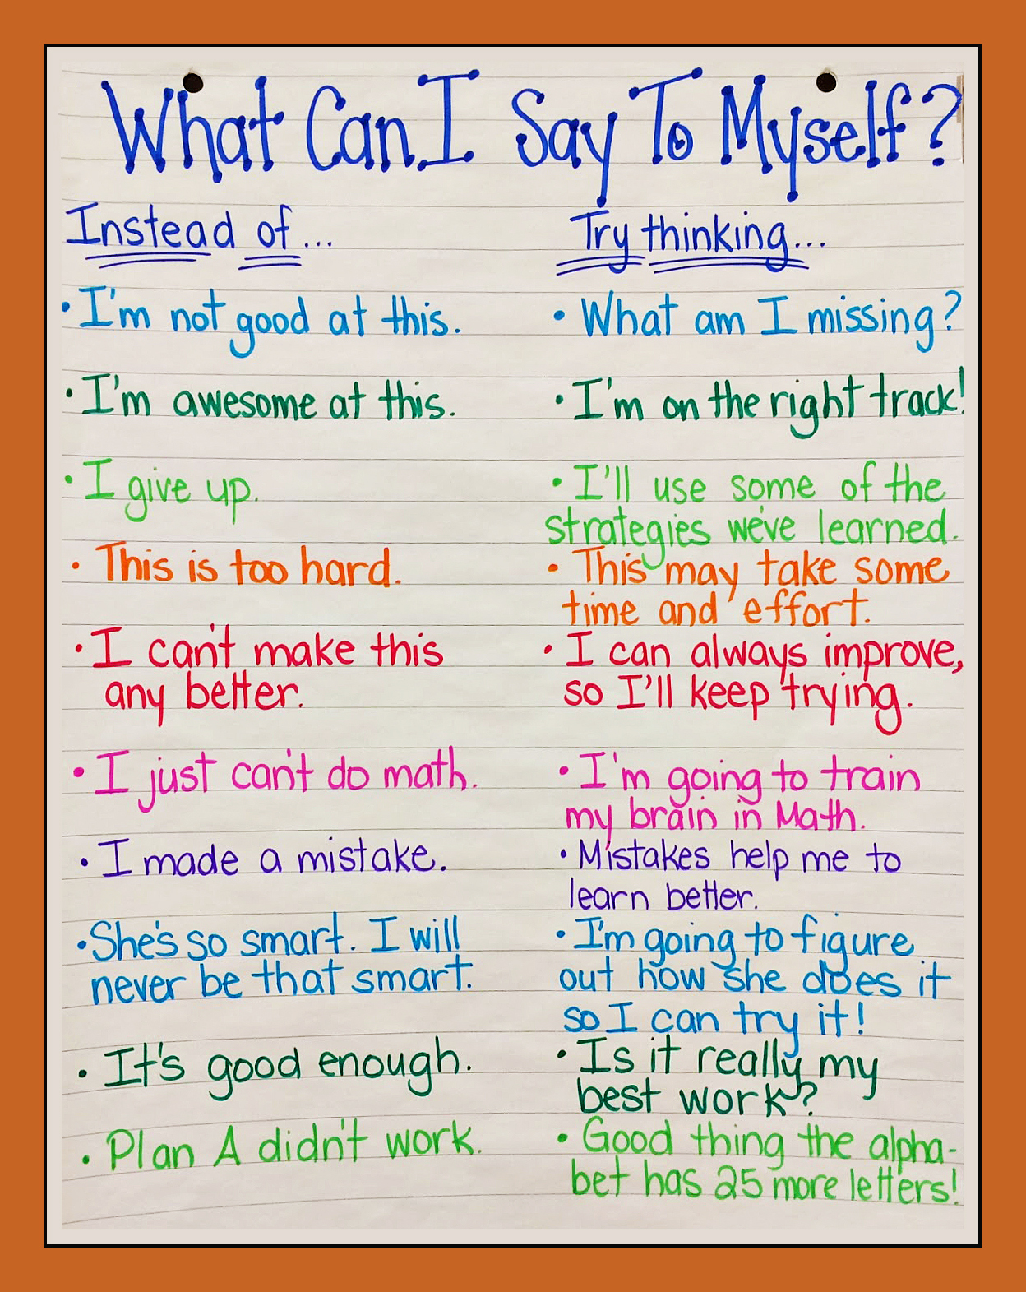
Positive and Negative Self Talk.
replace:
I can’t
with:
I’m going try
Never give up and always give it a try!
Success comes in cans, not in can’ts!

Slide 8
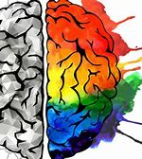
How To Look After Your Brain
https://youtu.be/12pbrkcfRDI

Slide 9
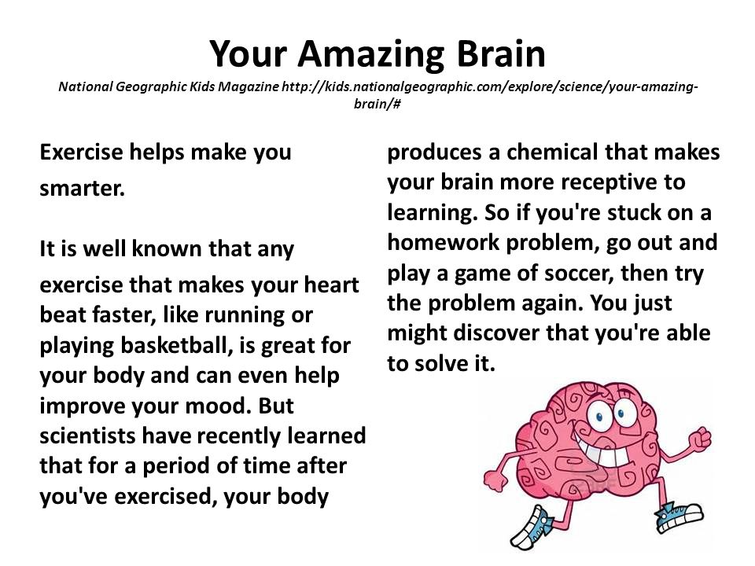
HOW DO YOU LOOK AFTER YOUR BRAIN

Slide 10
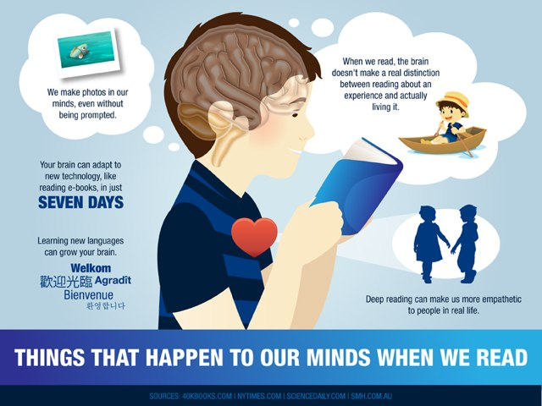

Slide 11
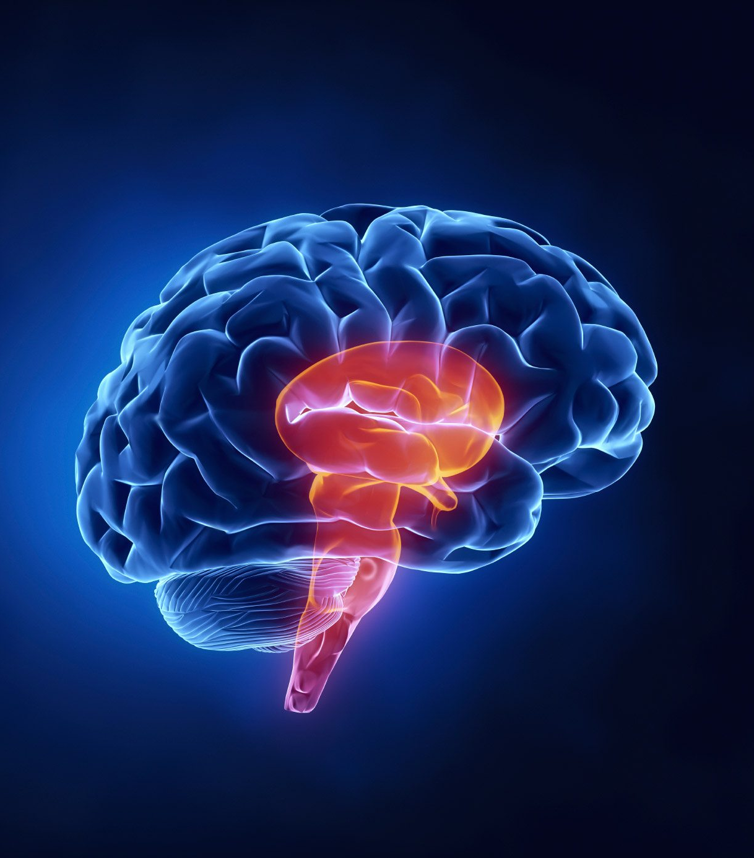
Fun Facts about the Brain for Kids. The neurons in your brain make enough electricity to generate a low-watt light bulb. Your neurons are joined by tiny pathways or roads. When you do something a lot – like ride your bike – the pathways in your brain that send messages about bike riding are strengthened. This is sort of like a walking path that you walk on every day.

